Slide 1
SSTable format - write
Sanghyun Cho, Jongki Park
E-Mail: 98shcho@naver.com
jkipark@dankook.ac.kr

Slide 2
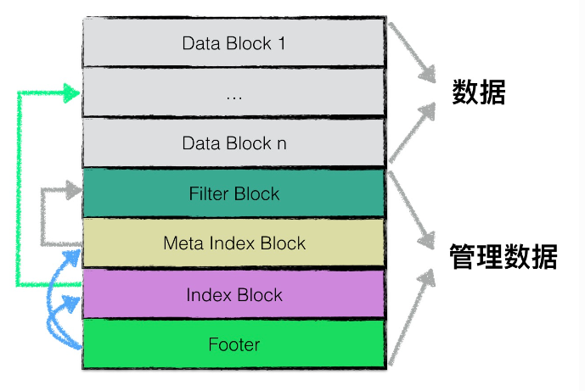
1. Building SSTable - overall 2. BuildTable() code flow 3. Appendix
Source : https://leveldb-handbook.readthedocs.io/zh/latest/sstable.html#

Slide 3
1. Building SSTable - Overall
BackgroundCompaction()
CompactMemTable()
WriteLevel0Table()
BuildTable()
PickLevelForMemTableOutput()
AddFile()
LogAndApply()

Slide 4
2. BuildTable() code flow
BuildTable()
Create TableBuilder()
Add()
Finish()

Slide 5
BuildTable code flow – TableBuilder::Add
Add()
Yes
Is Data Block Empty?
Add() (to Index Block)
Yes
Is the Bloom Filter Applied?
Addkey() (to Filter Block)
Add() (to Data Block)
Data Block size >= Block size ?
Flush()

Slide 6
BuildTable code flow – TableBuilder::Finish
Finish()
Flush()
Yes
Is the Bloom Filter Applied?
WriteRawBlock()
( = Write Filter Block)
WriteBlock()
( = Write MetaIndex Block)
WriteBlock()
( = Write Index Block)
Append()
( = Write Footer)

Slide 7
BuildTable code flow – TableBuilder::Flush
Flush()
WriteBlock()
BlockBuilder::Finish()
WriteRawBlock()
Yes
Is the Bloom Filter Applied?
StartBlock()

Slide 8
3. Appendix – Overall process (BuildTable)
MemTable
Add
...
Full
Last Data Block
BlockBuilder
(about Data Block)
BlockBuilder
(about Index Block)
FilterBlockBuilder
Flush
Data Block
Index Block
Data Block
Filter Block
Data Block
MetaIndex Block
Footer
Finish

Slide 9
Appendix – More about TableBuilder()
Member Variables
Options
BlockBuilder (about Data Block)
BlockBuilder (about Index Block)
FilterBlockBuilder
pending_index_entry
etc
Methods
Add
Flush
Finish
etc

